Slide 1


NAME TENT
Favourite Sport or thing to do
How you feel about maths
Favourite Music

Slide 2
I have a question about…
I would like you to know that…

Slide 3

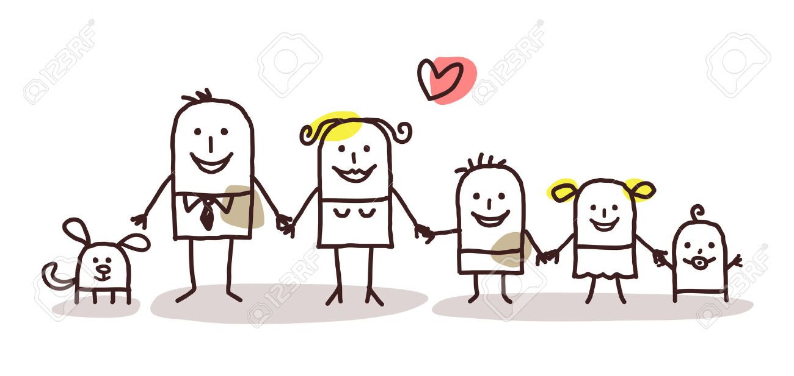
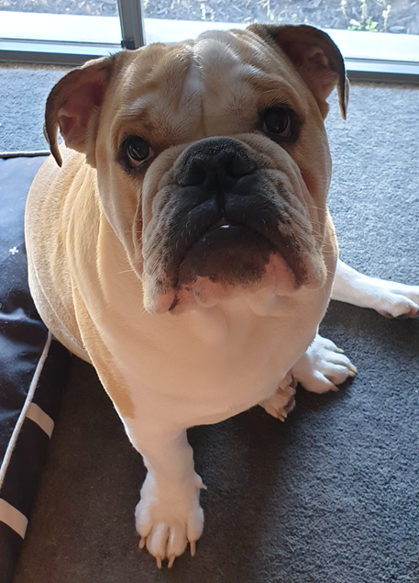


Slide 4
Games you could play…
Slaps
1, 2, 3…
Cobweb
2 truths and a lie
BINGO
This or That
Roll and respond
Other ideas at https://www.sessionlab.com/library/energiser

